Slide 1
Sentiment Analysis on Hotel Reviews Using Machine Learning Techniques
Frontier Tech Leaders Programme Global Cohort 1
Anas ALHARDI
Taha Mohammadyar
December 2023

Slide 2
Outline
Frontier Tech Leaders Programme Global Cohort 1
Concept note and implementation plan:
Background
Objectives
SDG Relation
Data
Methodology
Results
Deployment
Future Work

Slide 3
Concept note and implementation plan
Frontier Tech Leaders Programme Global Cohort 1

Slide 4
Background
Frontier Tech Leaders Programme Global Cohort 1
Project Overview: Analyzing sentiments in hospitality through machine learning for efficient processing of online hotel reviews.
Background: Manual review analysis is inefficient due to the overwhelming volume of online feedback. Our solution leverages machine learning to automate sentiment classification.
Importance: Critical for the hospitality industry, our project addresses the need for scalable and automated sentiment analysis, providing businesses with valuable insights for continuous improvement.
Notes:
As a background we have 3 point .. First …. Second … third

Slide 5
Objectives
Frontier Tech Leaders Programme Global Cohort 1
Our project aims to achieve the following:
Develop a machine learning model for sentiment analysis on hotel reviews.
Classify reviews into positive or negative categories.
Compare the performance of different machine learning algorithms.
By achieving these objectives, Our project helps the hospitality industry by better understanding how customers feel. This helps businesses improve their services and make decisions based on data
Notes:
Our project has three main golds …

Slide 6

SDG Relation
Frontier Tech Leaders Programme Global Cohort 1
This project aligns with SDG 8, which promotes decent work and economic growth. By automating the analysis of hotel reviews, businesses can gain valuable insights into customer sentiment, allowing them to make informed decisions that improve customer satisfaction, attract more guests, and ultimately boost their economic growth
Notes:
So whats the relationship between our project and SDG?

Slide 7
Data
Frontier Tech Leaders Programme Global Cohort 1
Source: TripAdvisor Hotel Reviews Dataset
Obtained from Kaggle.
20,491 customer reviews in English.
Structured into "Review" and "Rating" columns.
Data Features
Review Text:
Customer-generated hotel reviews.
Varied lengths and language styles.
Rating:
Numeric ratings provided by customers.
Scale from 1 to 5.

Slide 8
Methodology
Frontier Tech Leaders Programme Global Cohort 1
AI Method Used: Supervised Machine Learning
Objective: Sentiment analysis on TripAdvisor hotel reviews.
Data Cleaning:
Lowercasing, word splitting, stopword removal, Slang word conversion, rooting.
Model Exploration
Model Training:
Split data: 80% training, 20% testing.
Decision Tree, Logistic Regression, Naive Bayes, Random Forest, Voting Classifier.
Model Evaluation:
Accuracy, precision, recall, F1-score.
Confusion matrices for insights.

Slide 9
Evaluation Results
Frontier Tech Leaders Programme Global Cohort 1
The results will be compared with the following table, which shows the difference between the training accuracy and test accuracy of each classification algorithm.
Algorithm | Training Accuracy | Testing Accuracy
Decision Tree | 1.0 | 0.765
Logistic Regression | 0.9306 | 0.8889
Naive Bayes | 0.8333 | 0.6094
Random Forest | 1.0 | 0.8361
Voting Classifier | 0.9985 | 0.8611

Slide 10
Results
Frontier Tech Leaders Programme Global Cohort 1
In our project, we found that TripAdvisor hotel reviews are mostly positive (86.74%) and a small portion of them are negative (13.26%). These reviews show that TripAdvisor services accurately reflect user satisfaction.

Slide 11
Deployment
Frontier Tech Leaders Programme Global Cohort 1
Overview:
The final phase in transitioning from development to real-world application.
Model Serialization:
Conversion of the trained model into a serialized format.
Utilized joblib library to save the Logistic Regression model. The Logistic Regression model was chosen because it was the most accurate and efficient model among the models we tested..
Model Serving:
Loading the serialized model into the deployment environment.
Ensuring seamless integration with the deployment platform.

Slide 12
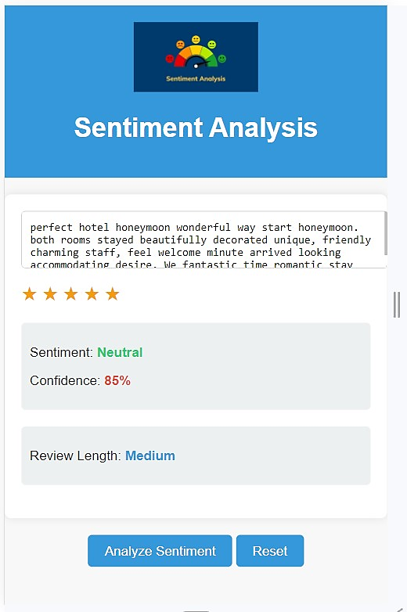
Deployment
Frontier Tech Leaders Programme Global Cohort 1
Integration Steps:
Frontend Design: Develop an interactive and visually appealing user interface.
Backend Connectivity: Establish a connection between the web page and the deployed model.
API Calls: Enable communication between the web page and the machine learning model via API calls.
Considerations:
Time Constraints: Limited deployment steps due to project timeframe.
Future Work: Outlined considerations for deployment in future iterations.
While deployment steps were not fully executed, the groundwork for future deployment is laid out.

Slide 13
Future Work
Frontier Tech Leaders Programme Global Cohort 1
Our project has lot’s of potential to be used not only in the hospitality sector but in many other areas as well. One avenue we are exploring involves extracting and analyzing a curated set of tweets from platforms like Twitter, gauging people's opinions and reactions towards issues, whether they be political, social, or emerging technological trends.
We believe that this is a project that can contribute a lot in the sentiment analysis area.

Slide 14
References
Frontier Tech Leaders Programme Global Cohort 1
[1] M. Hu and B. Liu, "Mining and summarizing customer reviews," in Proceedings of the tenth ACM SIGKDD international conference on Knowledge discovery and data mining, 2004, pp. 168-177.
[2] P. D. Turney, "Thumbs up or thumbs down? Semantic orientation applied to unsupervised classification of reviews," arXiv preprint cs/0212032, 2002.
[3] B. Pang, L. Lee, and S. Vaithyanathan, "Thumbs up? Sentiment classification using machine learning techniques," arXiv preprint cs/0205070, 2002.
[4] H.-X. Shi and X.-J. Li, "A sentiment analysis model for hotel reviews based on supervised learning," in 2011 International Conference on Machine Learning and Cybernetics, 2011, vol. 3: IEEE, pp. 950-954.
[5] J. R. Quinlan, "Induction of decision trees," Machine learning, vol. 1, pp. 81-106, 1986.
[6] J. R. Quinlan, C4. 5: programs for machine learning. Elsevier, 2014.
[7] S. Menard, Applied logistic regression analysis (no. 106). Sage, 2002.
[8] t. f. e. From Wikipedia. "Logistic regression." https://en.wikipedia.org/wiki/Logistic_regression (accessed 24 MAY 2023.
[9] T. Hastie, R. Tibshirani, J. H. Friedman, and J. H. Friedman, The elements of statistical learning: data mining, inference, and prediction. Springer, 2009.
[10] N. Vaish, N. Goel, and G. Gupta, "Machine learning techniques for sentiment analysis of Hotel Reviews," in 2022 International Conference on Computer Communication and Informatics (ICCCI), 2022: IEEE, pp. 01-07.
[11] S. Anis, S. Saad, and M. Aref, "Sentiment analysis of hotel reviews using machine learning techniques," in Proceedings of the International Conference on Advanced Intelligent Systems and Informatics 2020, 2021: Springer, pp. 227-234.
[12] D. Navanith, K. Likhith, M. S. Vardhan, and S. Kavitha, "Optimized Sentiment Analysis of Hotel Reviews using Machine Learning Algorithms," in 2022 6th International Conference on Electronics, Communication and Aerospace Technology, 2022: IEEE, pp. 1075-1081.

Slide 15


Thank you!
Frontier Tech Leaders Programme Global Cohort 1

